Slide 1


Chris Su
QML REU 2024 – Week 2 Update
Carnegie Mellon University
Mentors: Professor Suren Jayasuriya, Greg Vetaw
NSF Award 2349567

Slide 2
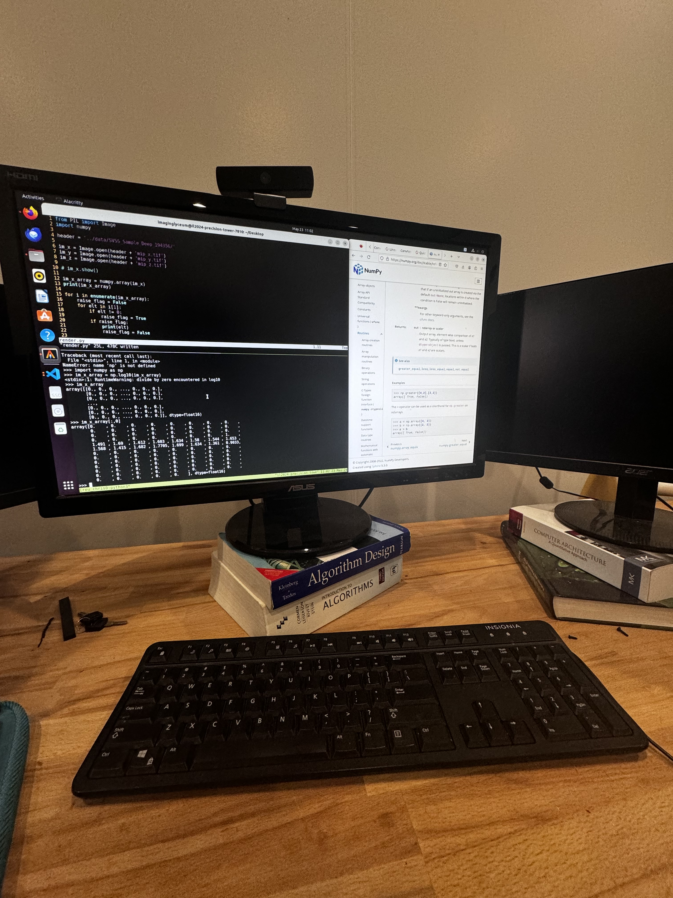
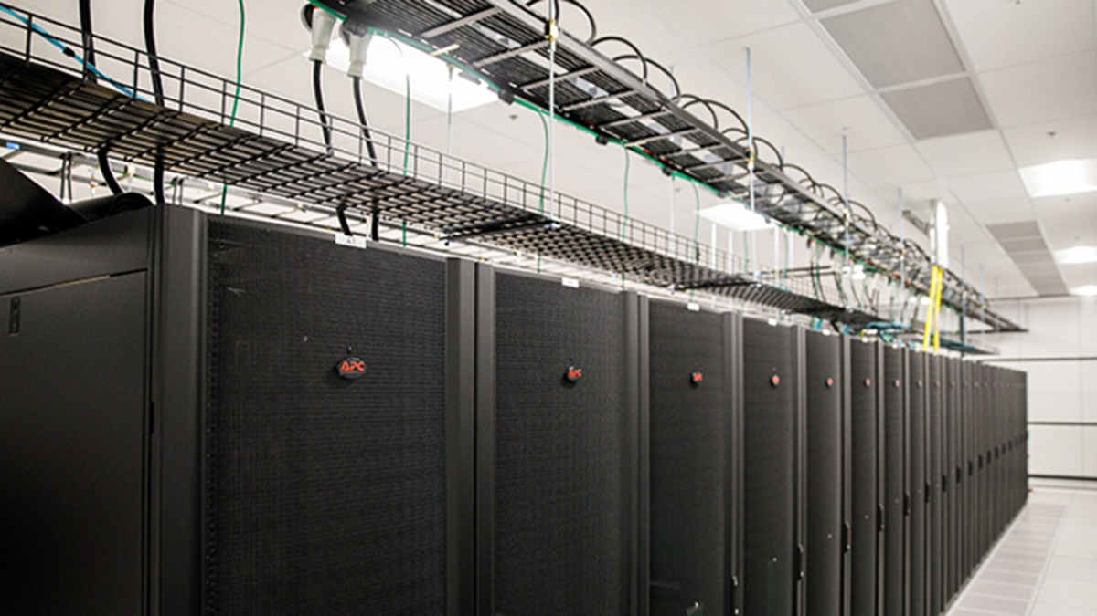
Week 2: Setting up!
Applied for Sol & Agave supercomputer access
Onboarding + setup for my linux machine

Slide 3
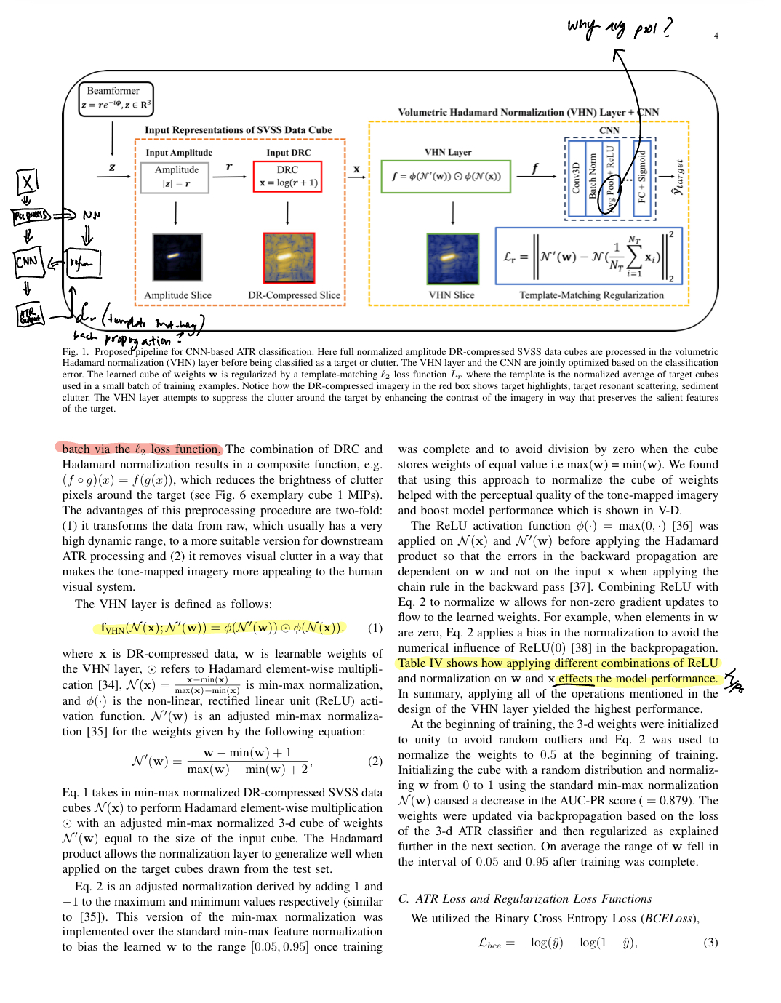
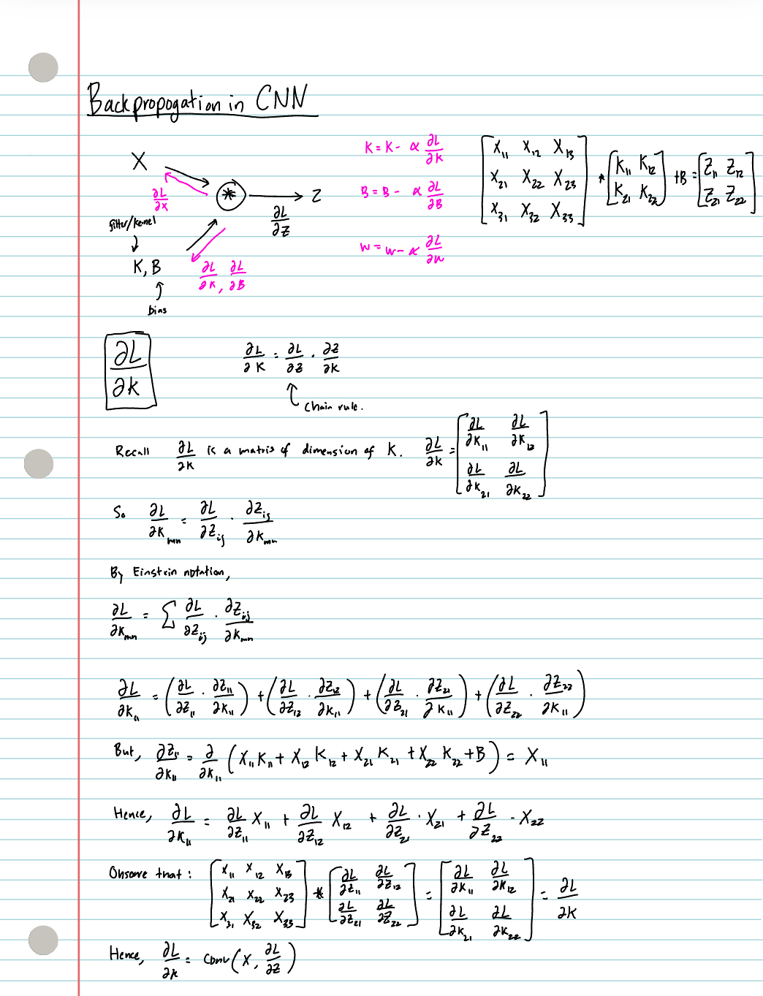
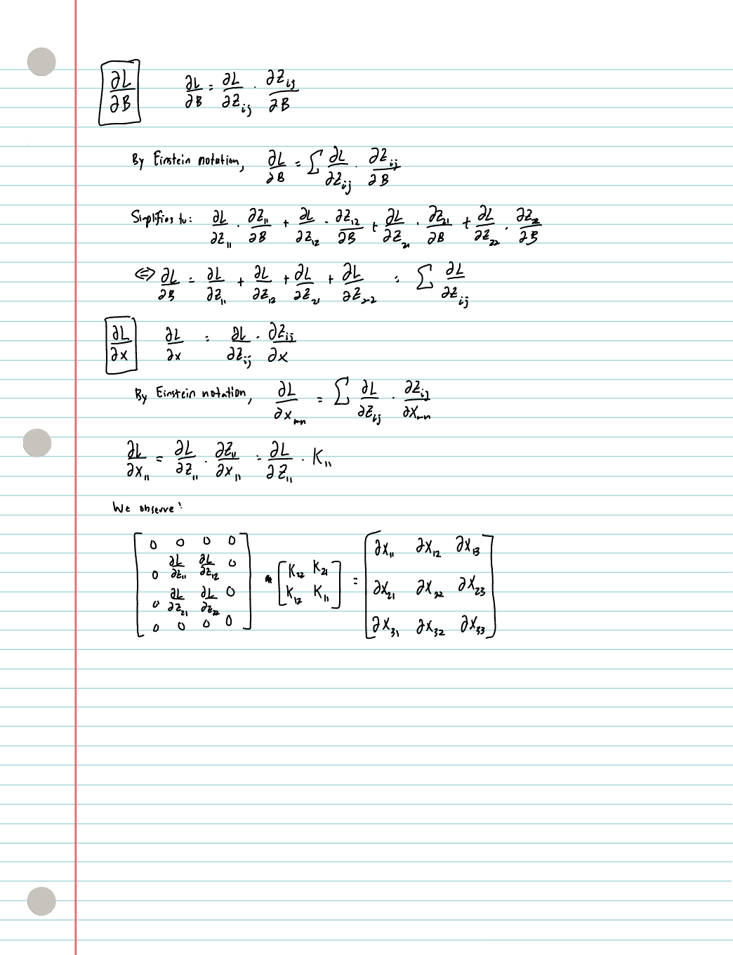
Week 2: Research!
Deeper dive into CNN infrastructure + backprop algo
Read my mentor’s paper

Slide 4
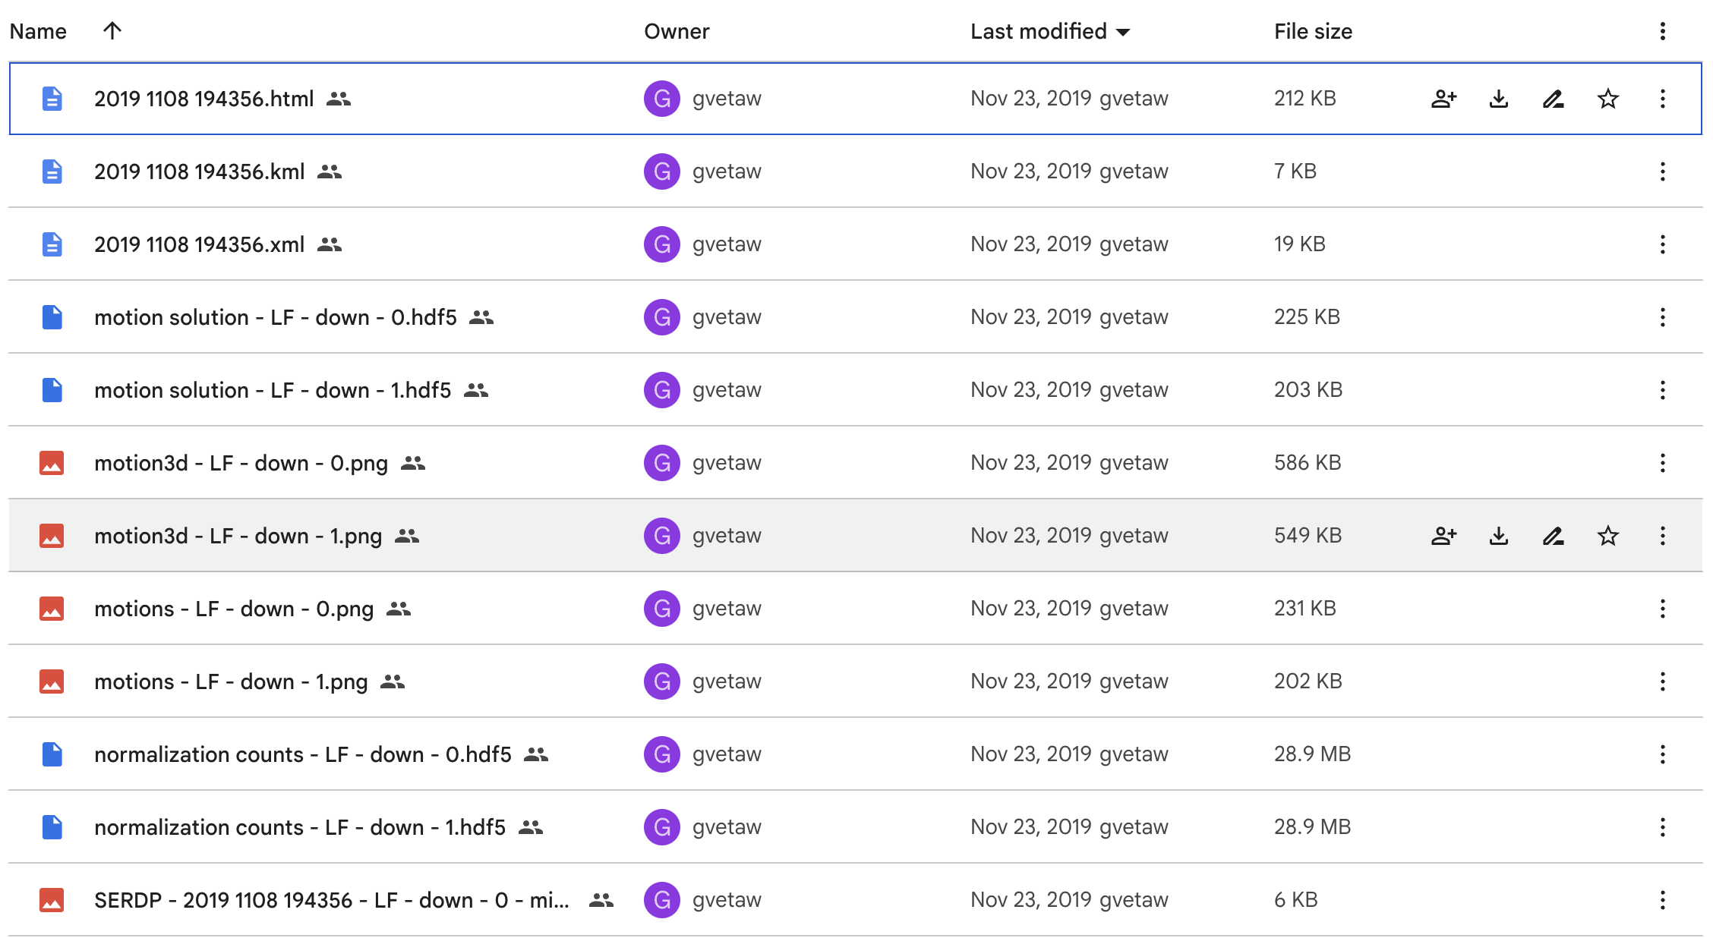
Goals for next week?
Brush up on weighted loss functions
Fill knowledge gaps in my understanding of the paper
Exploratory data analysis for my dataset (3D SAS data)
Hopefully get supercomputer access and start training!

